Slide 1

Paulding County School District
Counselors Present
Mission Possible: Graduation and Beyond
Supports BRIDGE Advisement

Slide 2
Your Son/Daughter is Graduating…

Slide 3
…So Now What?
Congratulations Seniors!
Only 2 semesters remain
All grades still count!
Graduation – May 22nd, 2020 or May 23rd, 2020

Slide 4
Heading to college or technical school?
Early decision binding acceptance
Meet all remaining deadlines during senior year and after graduation
  Deposits
  Final transcript
  Scholarships
  Housing
  Special Programs

Slide 5
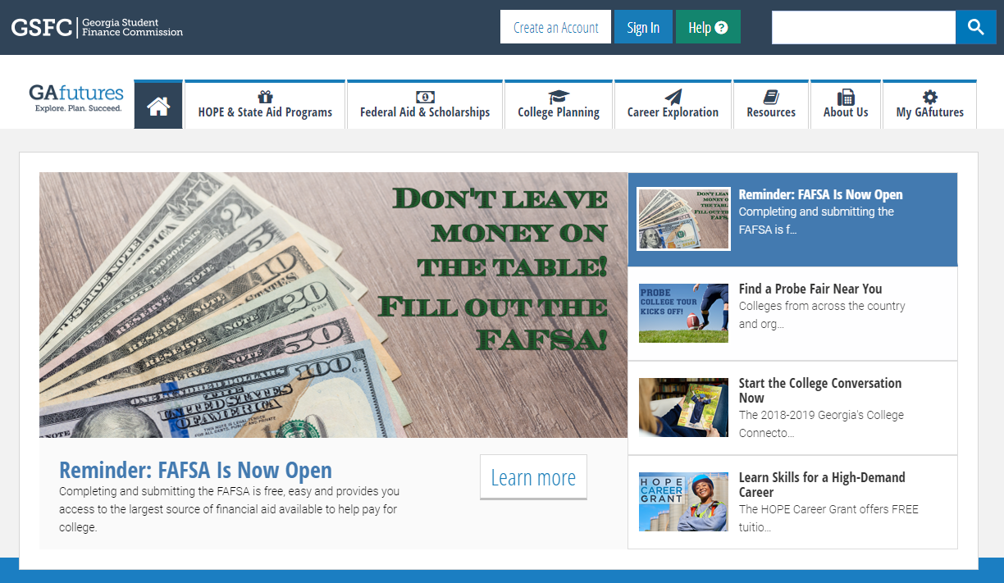
Important Website www.GAfutures.org
GAfutures (MyGAfutures Account)
  MyGAfutures GPA HOPE information
  College Applications in Georgia
  Scholarships
  FAFSA and Financial Aid
  Financial Literacy
  Move on When Ready Application
  to Georgia Student Finance
  Commission

Slide 6
SAT & ACT
Sign up now if student needs a better score or needs to take either or both tests
Make sure official scores (as well as official transcripts) are sent all Universities, Colleges and Technical Colleges and NCAA or NAIA clearinghouse, when appropriate
Make sure the testing date doesn’t conflict with an activity before it is paid for
Check deadlines for applications so student’s score is available to meet those deadlines
The opportunity at the local high school for SAT Prep is: Sept - Nov

Slide 7
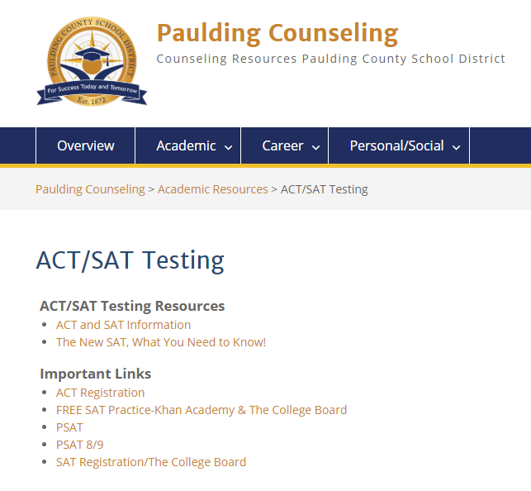
Note these Important Links on Counseling and Guidance Website https://counseling.paulding.k12.ga.us/index.php/academic/act-sat-testing/

Slide 8
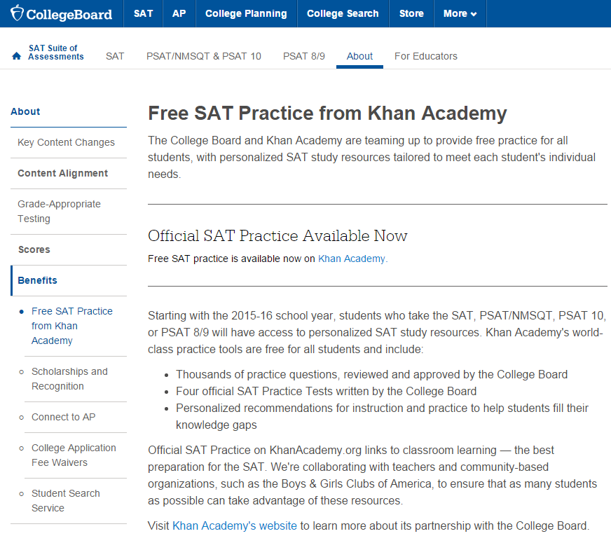
FREE SAT Practice from Khan Academy
https://collegereadiness.collegeboard.org/about/benefits/khan-academy-practice

Slide 9
Financial Aid 101 &
Scholarships
FAFSA (Free Application for Federal Student Aid) must be completed, even for HOPE Scholarship

Slide 10
FAFSA
Submit a paper application or apply on-line at www.fafsa.ed.gov
You must have income tax information
The FAFSA can be used to apply for the HOPE scholarship, as well as all other state and federal student aid
Getting Started FAFSA Link on GAfutures:
https://www.gafutures.org/federal-aid-scholarships/fafsa/
Videos are available, so please watch the videos.

Slide 11
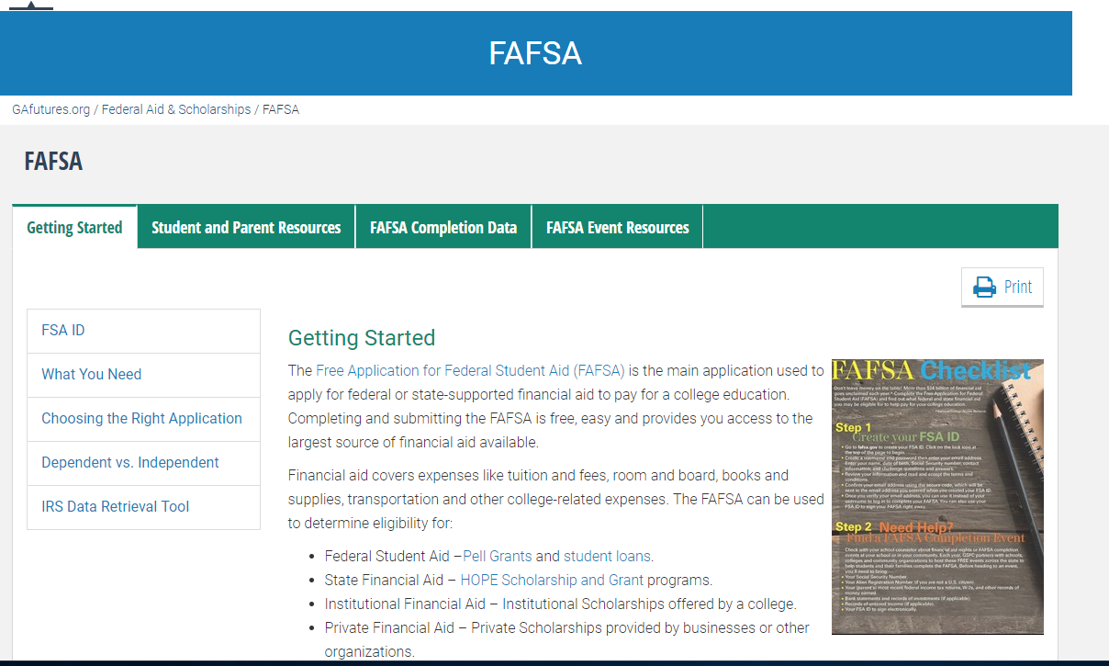
Getting Started and FAFSA Checklist https://www.gafutures.org/federal-aid-scholarships/fafsa

Slide 12
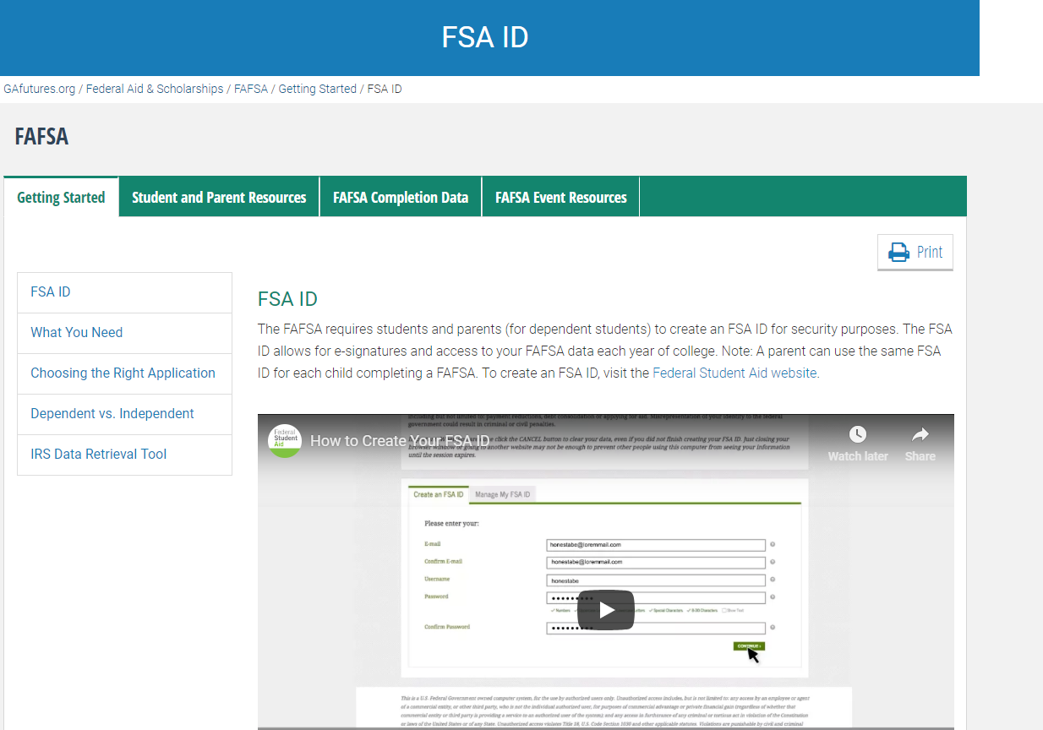
FSA ID https://www.gafutures.org/federal-aid-scholarships/fafsa/getting-started/fsa-id/

Slide 13
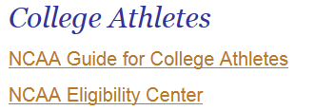
If your student is going to be a College Athlete…

Slide 14

It is important to understand the difference between these 3 types of funds.

Slide 15
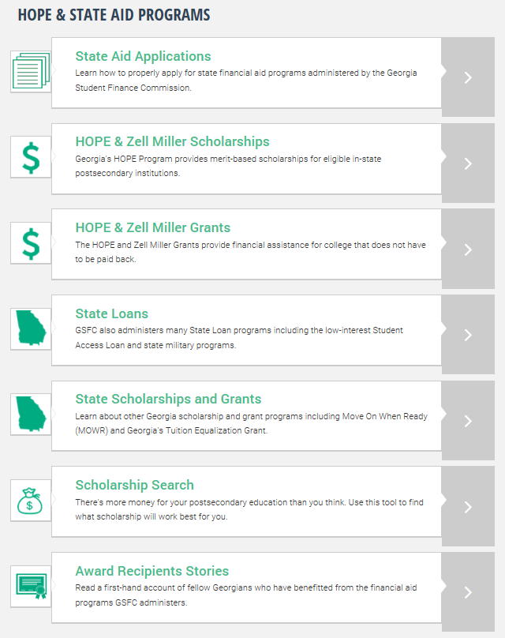
GAfutures link is: https://www.gafutures.org/hope-state-aid-programs/

Slide 16
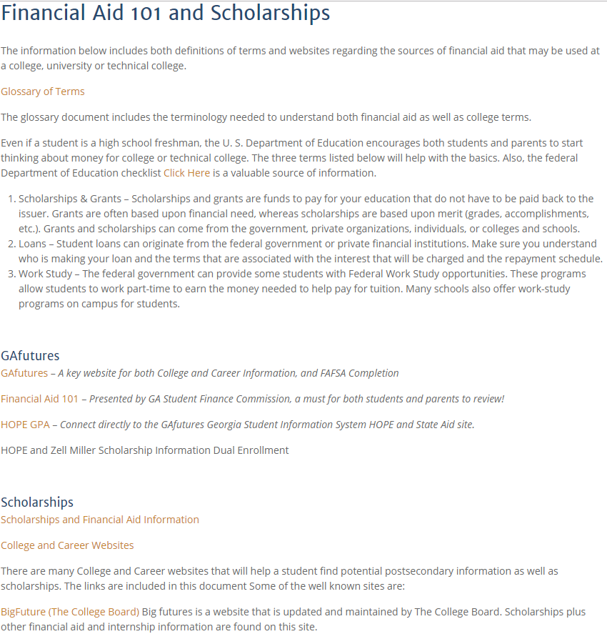
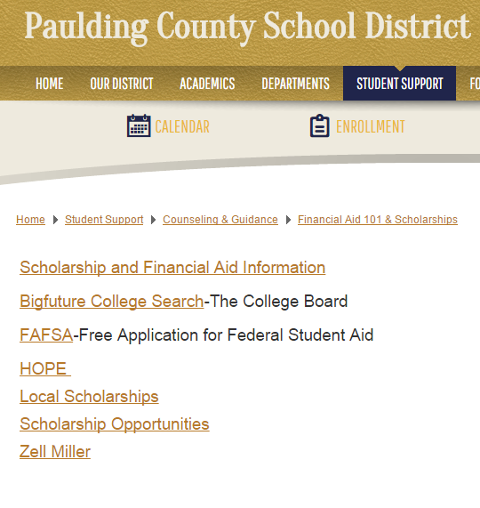
Scholarship Information https://counseling.paulding.k12.ga.us/index.php/career/financial-aid-101-and-scholarships/

Slide 17

HOPE Scholarship
You can apply for HOPE through either FAFSA or the e-HOPE electronic application at www.gsfc.org
  https://www.gafutures.org/hope-state-aid-programs/hope-zell-miller-scholarships/hope-scholarship/application-procedure-and-deadline/
3.0 Grade Point Average is required in all HOPE Eligible courses (core academics) except for middle school core courses recorded on the high school transcript.
The HOPE grade point average may be reviewed at anytime via the My GAfutures 411 student’s sign on.
All high school students must have a good, working email to have a GAfutures account.
Paulding County downloads each Senior’s high school transcript at the close of each semester to the Georgia Student Finance Commission via GAfutures

Slide 18
HOPE GPA Eligibility
District HS transcript is a numeric grade point average, example 83.4%
  All courses on the entire high school transcript count and this GPA is used to determine class rank
  District transcript also has a weighted and unweighted 4.0 GPA
    This is not the same as the HOPE GPA.
HOPE GPA – 4.0 scale
  All academic courses count, even academic electives except a core course in middle school for which the student earned high school credit (ex: Spanish I)
  Fine Arts, PE, CTAE courses do not count towards HOPE GPA unless the CTAE course is identified as a HOPE Eligible course
  An 83.4% weighted GPA on the Paulding County School District transcript may not mean that the there will be a 3.0 HOPE eligible GPA
  Students must monitor the HOPE eligible GPA on their My GAfutures account after each semester

Slide 19
HOPE Scholarship
Again note…..3.0 Grade Point Average in all academic courses
AP (Advanced Placement) courses will receive a .5 weight by Georgia Student Finance Commission
  There is no .5 weight added to an A grade.
Dual Enrollment Move on When Ready courses completed in the 13-14 and year’s thereafter school year will be weighted with a .5 weight by Georgia Student Finance Commission.
Dual Enrollment Move on When Ready core courses completed in the 14-15, 15-16, and current school year are weighted 10 points on the high school transcript. MOWR courses completed prior to July 1, 2014 were weighted on district transcript.
Even if student is eligible, student will not receive HOPE, if there is no match among:
  Infinite Campus (student information system)
  FAFSA (Free Application for Federal Student Aid)
  My GAfutures account
  College/university application
  Financial aid documentation at college, university, and/or technical college
  PLAN AHEAD to avoid last minute stresses that could effect HOPE !!!

Slide 20

Areas that cause an eligible student not to show eligible for the HOPE:
  999 number is in the student information system rather than valid Social Security Number
  Incorrect Social Security Number
  Incorrect Legal Name
  Incorrect birth date and/or high school name
  Student must carefully and continually check HOPE information on the MyGAfutures account and talk to the school counselor if there are any issues

Slide 21
HOPE Information
The HOPE Scholarship will pay a percentage amount of the standard tuition charges from the previous year for a 3.0 Core GPA.
Website for HOPE amounts is on the HOPE Fall 2019 information chart on GAfutues. These amounts are for the 2019-20 school year only.
HOPE will not pay for remedial or developmental courses

Slide 22
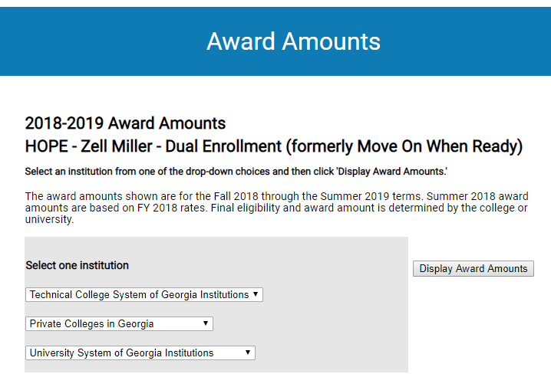
Award Amounts
https://apps.gsfc.org/SecureNextGen/dsp_award_amounts.cfm

Slide 23
Zell Miller
Zell Miller Scholar Program
  Must meet all HOPE requirements
  Must graduate with a 3.7 GPA in Core Subjects as calculated by GSFC
  Must have a 1200 SAT Score in Critical Reading and Math from one test OR
  Must have a 26 ACT Composite Score from one test
  Must have SAT and/or ACT scores before graduation date to GSFC; Testing service sends scores to GSFC; Parent and student need to be certain that GSFC has scores;
  Scores of tests taken in June after graduation are not used

Slide 24
HOPE GRANT
  There is not a GPA requirement for the HOPE Grant as a student leaves high school.
  Students might consider going to a technical college on the HOPE Grant and choosing one of these options:
    Complete a Certificate or Diploma Program
    Complete 30 semester college hours and transfer to college or university
  Link for HOPE Grant information: https://www.gafutures.org/hope-state-aid-programs/hope-zell-miller-grants/hope-grant/eligibility/

Slide 25
Transcript Requests During Year for Admissions and Scholarship Applications
University System of Georgia Schools will receive transcripts via GAfutures
Technical College System of Georgia Schools will also receive transcripts via GAfutures
Private GA Colleges receive GAfutures transcripts
Transcripts for out-of-state schools and for other reasons will be printed off and mailed or processed via Scriborder
There needs to be plenty of lead time for transcripts to accompany college and scholarship applications

Slide 26
Final Transcript Request in June
At the end of the school year a final transcript to the college or technical college must be sent either via GAfutures or mailed.
This request may be completed electronically by the student for all University System of Georgia Schools, TCSG and private colleges in GA through the students MyGAfutures account.
For out-of-state transcripts, students must submit the school’s complete address when requesting a transcript

Slide 27
Immunization
Colleges and technical colleges require proof of immunization for entering freshmen
If you do not have this at home, please request a copy from your family physician

Slide 28
Local Scholarships
Local scholarships are available for Seniors
Also, students may still apply for scholarships that are linked to the postsecondary school after starting college and throughout postsecondary education years-Example: Kennesaw State University offers scholarships in multiple fields
District Website has scholarship information on the Financial Aid 101 & Scholarships Link

Slide 29
If College is the choice….
On-campus housing vs. Off-campus housing
Location
Price
Experiences
Convenience
Responsibility

Slide 30
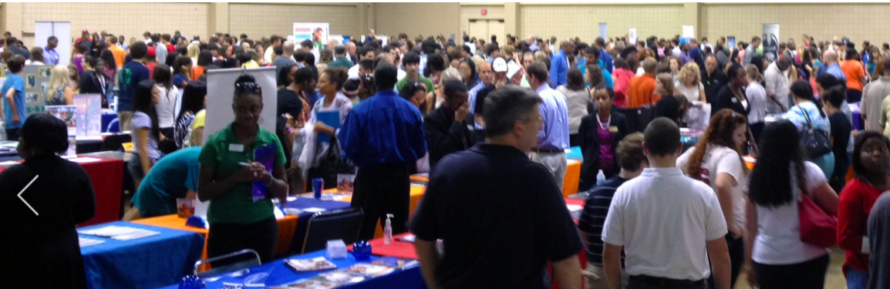
PROBE FAIR, September 10th, 6-8 p.m.
Paulding County High School
The Probe Fair is an excellent time to visit with college, university, technical college and military representatives.

Slide 31
Not everyone will make the decision to go to college or technical college next year…..
Again, you and your student can find valuable information on the career exploration section of the GAfutures website
https://www.gafutures.org/career-exploration/
Learn about:
  Yourself
  Exploring Careers
  Georgia’s Career Clusters and Pathways
  Skilled Trades-Go Build Georgia
  Military

Slide 32
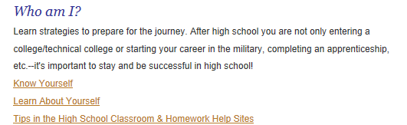
Who am I? Resources on Counseling Information Website

Slide 33
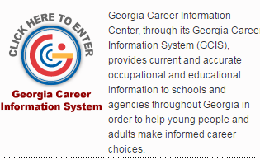
Career Exploration and Planning www.gcic.peachnet.edu

Slide 34
High School Students Profiles
Each high school student including Seniors has a Profile account on GCIS
All GCIS exploration and work completed are saved to the student‘s profile.

Slide 35
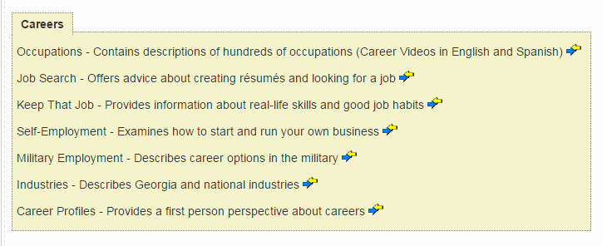
Career Information on GCIS

Slide 36
GCIS
US Schools outside of GA
Additional financial aid information
Programs of Study and Training Information

Slide 37
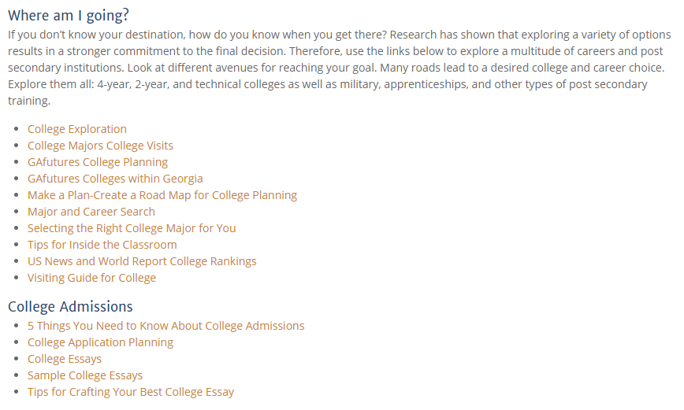
Where am I Going? Resources

Slide 38


Be reminded about Youscience results and the importance of using that information for future decisions

Slide 39
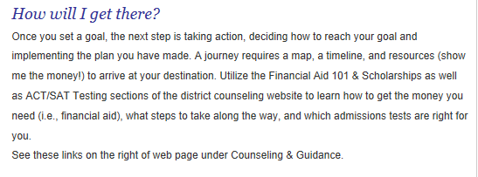
How Will I Get There?

Slide 40
Senior Capstone Project
The Senior Capstone Project is the culminating activity of a student’s high school career. The Capstone Project is embedded in the senior curriculum and will count as a percentage of the grade in core senior course(s). The Capstone Project provides students with the opportunity to demonstrate their knowledge and showcase the skills they have acquired over the past eleven years. It fosters lifetime interests and learning habits while providing students with a sense of accomplishment. The Capstone Project combines academic, career, and business/community components intended to challenge each student’s ability, stretch their limitations, and celebrate their individuality. The Senior Capstone Project is a fitting conclusion to a student’s high school education.

Slide 41
Senior Capstone Project Goals
To provide students with the opportunity to apply knowledge and skills acquired in their courses to a project relating to a career interest area.
To allow students to extend their academic experience into areas of personal career interest and to work with new ideas, organizations, and individuals.
To refine research skills and demonstrate proficiency in written and oral communication skills.

Slide 42
Components of the Project
PROJECT PROPOSAL: At the end of their junior year or beginning of the senior year, students will choose a career field or work related skill to research. Students may use Youscience results or tools from GAfutures and/or GCIS to narrow their topic of research along with faculty advisors and school counselors. The project begins during the first few weeks of school their senior year.
RESEARCH PAPER: Typically, in the students’ senior English class, students will write a research paper after researching their approved proposal topic. The research must be a worthwhile stretch beyond what is commonly known about the topic.
PROJECT PORTFOLIO: The purpose of the portfolio is to document the entire Senior Capstone Project process from inception to completion. The portfolio is submitted according to each high school’s requirements.
MENTOR: As part of the project, students must enlist a mentor to assist in learning more about their selected career area or area of interest. The mentor must be someone who is knowledgeable in the chosen area or someone working in the field. It is the student’s responsibility to obtain a mentor. If a mentor is not available locally, students and their parents may opt for virtual mentoring.

Slide 43
Components of the Project
PRESENTATION: Students will engage in a formal presentation. Students demonstrate proficient speaking skills and the ability to communicate coherently as they present and defend their Capstone Project. The presentation must be accompanied by tangible evidence/application of the skills acquired from the project.
Work-based Learning Course students complete this project as part of their Work-based Learning requirements.

Slide 44
Senior Letter
This is the guide to meeting graduation requirements!
Counselors Review the senior letter with each senior during august and/or September

Slide 45
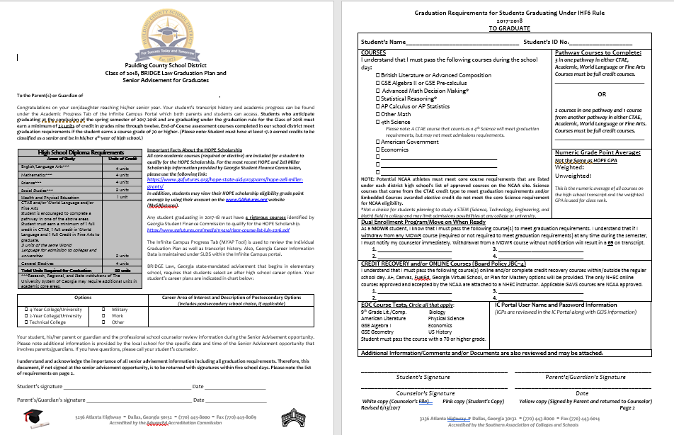
Senior Letter

Slide 46
Senior Letter – Page 1
Graduation Requirement Chart
  Counselors have audited your senior’s transcript history.
  Please remember counselors are supporting your student to be a Pathway Completer with 3 sequential courses in CTAE or Fine Arts or World Language.
  Counselors consult with students about meeting graduation requirements with one full credit in each of these three areas: CTAE, Fine Arts and World Language, if the student is not a pathway completer.
Making Decisions About the Next Step After High School
Very important - 2 credits in the same World Language must be earned to be admitted some two and all four-year colleges and universities.

Slide 47
Senior Letter-Page 2
Courses are listed that must be completed to graduate.
Pathway completion courses are documented.
Online and Credit Recovery Courses are listed, if applicable.
Any other information specific to your student is also noted on page 2 by the school counselor.

Slide 48
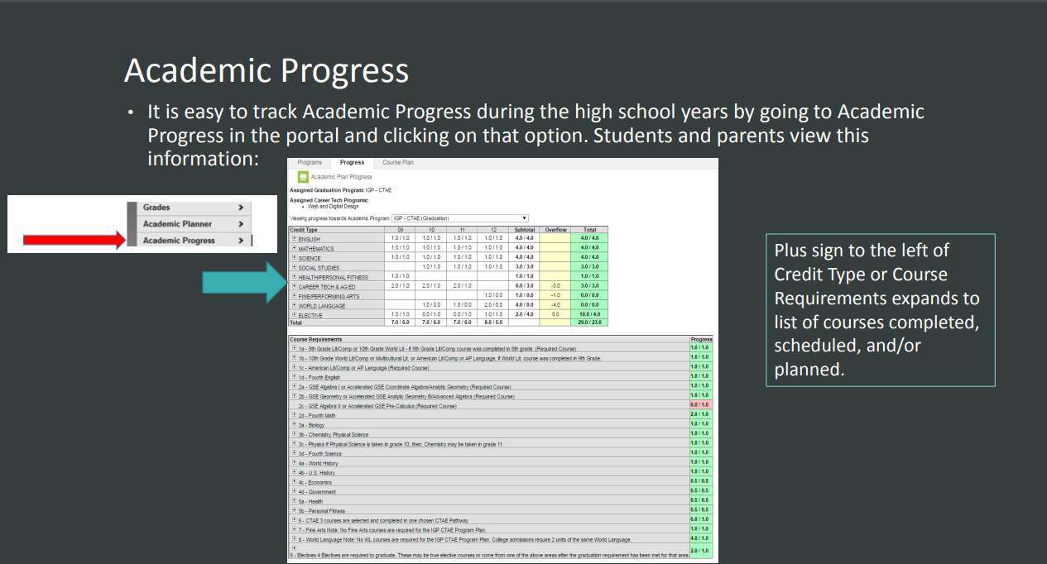
MYAP IC Portal
Remember to view your student’s Academic Progress under the IC Portal using the Academic Progress Tab.

Slide 49
To keep you and your student organized this year….
Use the Advisement Checklist on the High School Counseling page of the district website.
There are items to be reviewed and completed each month on the student’s checklist.
As you monitor the list each month, you will know what information your student is getting at the high school to be College and Career Ready.

Slide 50
Just to Review, Important Links on PCSD Counseling & Guidance Website are:
ACT/SAT Testing
Advisement
High School Counseling
Financial Aid 101 & Scholarships
http://www.paulding.k12.ga.us/domain/209

Slide 51
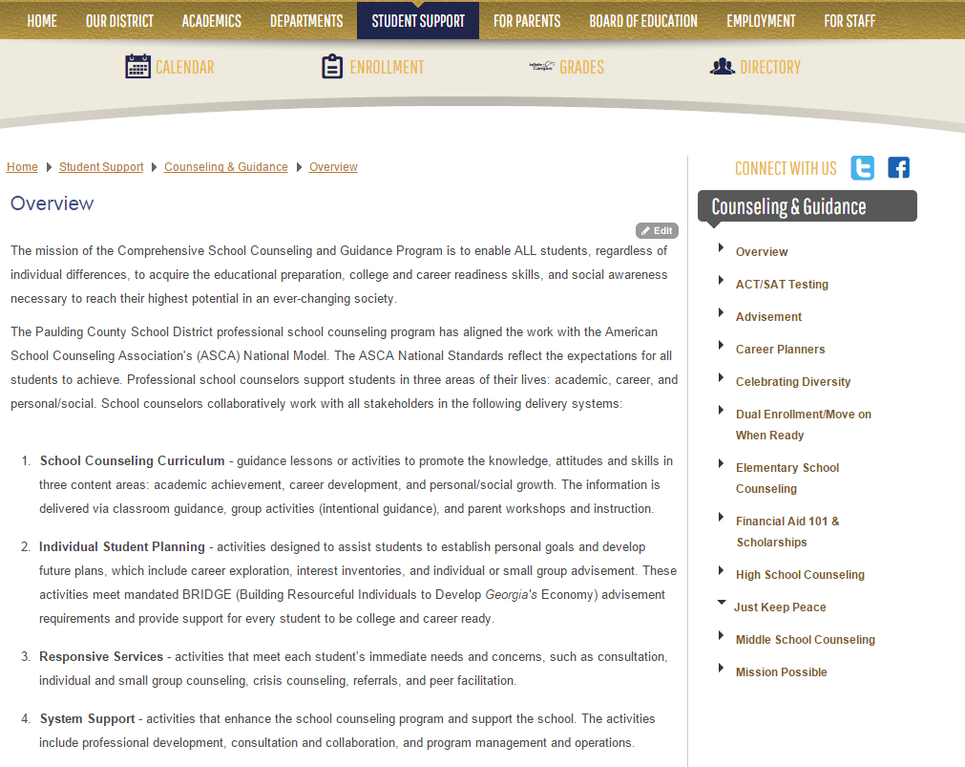

Slide 52

Congratulations Class of 2020!

